Slide 1
ΕΠΛ323 - Θεωρία και Πρακτική Μεταγλωττιστών
Lecture 3a
Lexical Analysis
Elias Athanasopoulos eliasathan@cs.ucy.ac.cy

Slide 2
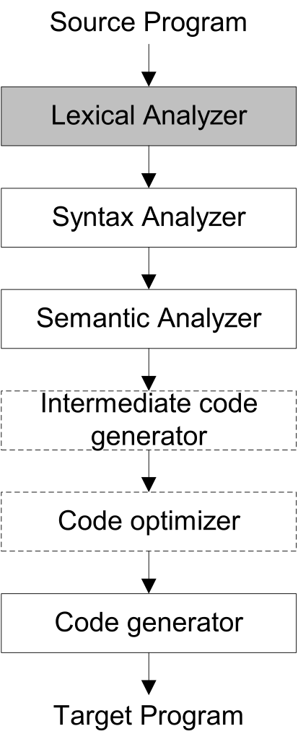
Lexical Analysis Λεκτική Ανάλυση
Definitions
Tokens, patterns, lexemes
Regular Expressions
Transition Diagrams
Finite Automata
Non-deterministic (NFA)
Deterministic (DFA)

Slide 3
The Role of Lexical Analysis
token
source program
lexical analyzer
parser
syntax analysis
get next token
symbol table

Slide 4
Lexical Analysis Properties
First phase of the compiler
Reads the input characters (source program)
Heavy I/O, many techniques for speeding up the process
De-beautifies the source (strips comments, white-space)
Keeps state for error-reporting (line numbers)
Sometimes implements the pre-processor
Produces a sequence of tokens that the parser uses for syntax analysis
Separation of lexical-syntax analysis is mostly for a clean design

Slide 5
Lexical-Syntax Analysis Separation
Simpler design
Syntax analysis without comments and white-space is simpler
Efficiency
Specialized buffering for reading the source program
Portability
Handling of special characters/alphabets is isolated

Slide 6
How it works?
Convert source code stream to a series of tokens
if (x1*x2 < 1.0) {
y = x1;
}
i
f
(
x
1
*
x
2
<
1
.
0
)
{
\n
Keyword: if
(
Id: x1
*
Id: x2
<
Num: 1.0
)
{
Id: y

Slide 7
Tokens Διακριτικά
Identifiers (αναγνωριστικά)
x, y11, elsex, _i00
Keywords (δεσμευμένες λέξεις)
if, else, while, break
Constants (σταθερές)
2, 1000, -500, 5L, 2.0, 0.00020, .02, 1., 1e5
Operators and symbols (τελεστές ή σύμβολα)
+ * { } ++ < << [ ] >=
Strings (αλφαριθμητικά):
“x”, “He said, \“Are you?\””
Comments (σχόλια)
/** comment **/

Slide 8
Challenges
Several different formats
2.e0, 20.e-01, 2.0000
Context is significant
if (x == 0) a = x<<1;
iff (x == 0) a = x<1;
DO 5 I = 1.25 // DO5I = 1.25
DO 5 I = 1,25 // LOOP, 1 to 25, step 5
Keyword-less languages (e.g., PL/I)
IF THEN THEN THEN = ELSE; ELSE ELSE = THEN;

Slide 9
Tokens – Patterns – Lexemes Δικριτικά – Πρότυπα – Λέξεις
Tokens (διακριτικά)
Elements of the language (identifiers, keywords,etc.)
Pattern (πρότυπο)
A rule that if applied to a set of strings (or text) generates the same token
Lexeme (λέξη)
A sequence of characters in the source program that is matched by the pattern for a token

Slide 10
Example
const pi = 3.1456;
The substring pi is a lexeme for the token “identifier”

Slide 11
Attributes for Tokens
E = M *C ** 2
<id, pointer to symbol-table entry for E>
<assign_op, >
<id, pointer to symbol-table enry for M>
<mult_op, >
<id, pointer to symbol-table entry for C>
<exp_op, >
<num, integer value 2>

Slide 12
Specification of tokens
How we match tokens?

Slide 13
Definitions
Alphabet (αλφάβητο)
Finite set of symbols
E.g., {0,1} is the binary alphabet
String (συμβολοσειρά)
Finite set of symbols drawn from the alphabet
ε is the empty string
|x| is the size of string, banana is a string of size 6
Language (γλώσσα)
Any set of strings constructed using an alphabet
E.g., {ε}, ∅, {01, 00, 11, 10}

Slide 14
String operations
prefix of s | A string obtained by removing zero ore more trailing symbols of string s; e.g., ban is a prefix of banana
suffix of s | A string formed by deleting zero ore more of the leading symbols of s; e.g., nana is a suffix of banana
substring of s | A string obtained by deleting a prefix and a suffix form s; e.g., nan is a substring of banana
proper prefix, suffix, or substring of s | Any nonempty string x that is, respectively, a prefix, suffix, or substring of s such that s ≠ x
subsequence of s | Any string formed by deleting ero ore more not necessarily contiguous symbols from s; e.g., baaa is a subsequence of banana

Slide 15
Operations on Languages
Concatenation (συνένωση ή παράθεση)
Union (ένωση)
Closure (κλείσιμο)

Slide 16
Concatenation Συνένωση
Assume languages, L and Μ, their concatenation, L∩M, or LM is
LM = { st | s ∈ L and t ∈ M }
s, t are strings
Example
L = {A, B, C, …, Z}
M = {0,1,2, …, 9}
LM = {A0, A1, …, B0, B1, …}

Slide 17
Exponentiation Ύψωση σε δύναμη
L⁰ = {ε}
L^{k} = {s₁ s₂ … s_{k} | s_{i} is in ∈ L, i=1,..,k}

Slide 18
Union Ένωση
Assume languages L and Μ. Their union, L∪M, is
L ∪ M = { s | s ∈ L or s ∈ M}
s is string
Example
L={A, B, C, …, Z}
M={0,1,2,…,9}
L∪M = {A, B, C, …, Z, 0,1,2,…,9}

Slide 19
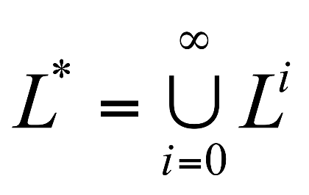
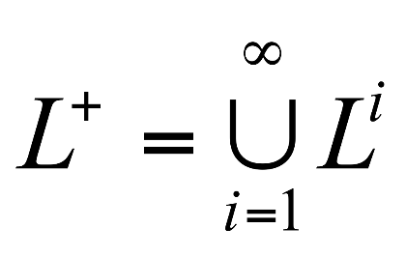
Closure Κλείσιμο
Kleene closure of L
L* denotes “zero ore more concatenations of” L
Positive closure of L
L+ denotes “one ore more concatenations of” L

Slide 20
Examples
L = {A, B, …, Z, a, b, ... z}, i.e., all letters
D = {0, 1, ..., 9}, i.e., all digits
L ∪ D is the set of letters and digits
LD is the set of strings consisting of a letter followed by a digit
L⁴ is the set of all four-letter strings
L* is the set of all strings of letters, including the empty string
L(L ∪ D)* is the set of all strings of letters and digits beginning with a letter
D⁺ is the set of all strings of one or more digits

Slide 21
Regular Expressions Κανονικές Εκφράσεις
In Pascal, an identifier is a letter followed by zero or more letters
I.e., it is a member of the set L(L ∪ D)*
We use regular expressions to define such sets
letter (letter | digit) *
Each regular expression r over an alphabet denotes a language L(r)

Slide 22
Rules
ε is a regular expression that denotes {ε}, i.e., the set containing the empty string
If a is a symbol in alphabet Σ then a is a regular expression that denotes {a}
a is used for the symbol, the string and the regular expression
Suppose r and s regular expressions denoting the language L(r) and L(s)
(r)|(s) is a regular expression denoting L(r) ∪ L(s)
(r)(s) is a regular expression denoting L(r) L(s)
(r)* is a regular expression denoting L(r)*
(r) is a regular expression denoting L(r)

Slide 23
Operator precedence Προτεραιότητες
The unary operator * has the highest precedence and is left associative
Concatenation has the second highest precedence and is left associative
| has the lowest precedence and is left associative
(a) | ((b)*(c)) is equivalent to a|b*c

Slide 24
Regular Expressions Algebra
r|s = s|r | | is commutative
r|(s|t) = (r|s)|t | | is associative
(rs)t = r(st) | concatenation is associative
r(s|t) = rs|rt (s|t)r = sr|tr | concatenation distributes over |
εr = r rε = r | ε is the identify element of concatenation
r* = (r|ε)* | relation between * and ε
r** = r* | * is idempotent

Slide 25
Shorthands
+: “one or more instances of” r⁺ is equal to (L(r))⁺
?: “zero or one instance of” r? equal to r|ε
[a-z]: {a, b, …,z}, equal to a|b|c|d…|z
[^a-z]: not in set {a, b, …,z}

Slide 26
Regular definitions
A frequently used regular expression can be named for delivering additional regular expressions
Pascal Identifiers (e.g., x1, y, velocity100, etc.)
letter ➔ A | B | . . . | Z | a | b | . . . | z
digit ➔ 0 | 1 | . . . | 9
id ➔ letter (letter|digit)*

Slide 27
Example 1
Unsigned numbers in Pascal
5280, 39.37, 6.336E4, 1.894E-4
digit ➔ 0 | 1 | . . . | 9
digits ➔ digit digit*
opt_frac ➔ . digits | ε
opt_exp ➔ (E(+|-|ε)digits)|ε
num ➔ digits opt_frac opt_exp

Slide 28
Example 2
Unsigned numbers in Pascal
5280, 39.37, 6.336E4, 1.894E-4
digit ➔ 0 | 1 | . . . | 9
digits ➔ digit+
opt_frac ➔ (. digits)?
opt_exp ➔ (E(+|-)?digits)?
num ➔ digits opt_frac opt_exp

